Slide 1

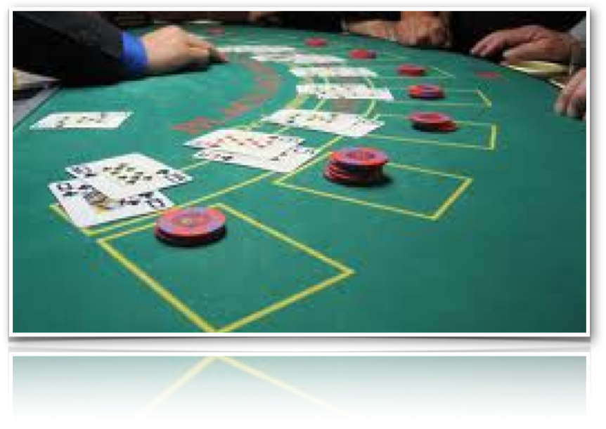
BLACKJACK PLAYER EVOLUTION

Slide 2
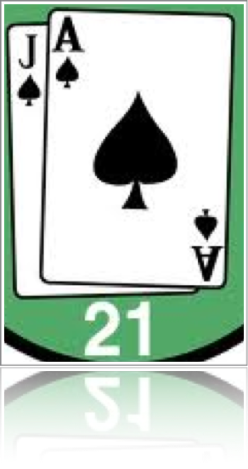
THE PROBLEM
“Can I evolve a Blackjack policy better than the dealer knowing ONLY the goal of the game?”
QUESTIONS
What does "better" mean?
How much better?
ANSWERS
Under the same conditions, I win more often
Let's go for broke! I want to be 100% better!

Slide 3
ENCODING
Policies: 28bit strings representing hit/stand for each of 28 states
States: 4 - 22 (where 22 = BUST, and 12.5 etc. are soft)
Simulating Games: Move to random higher state on hit
Fitness: Who got more wins following his policy at state n
HOW MUCH BETTER CAN WE GET?

Slide 4
EVOLUTION PARAMETERS
Inheritance: Learn from opponent i.e. The Dealer
Selection: Opponent gene must be at least 50% better than mine to inherit; Elitist Selection
Crossover: Steal genes from the opponent; Non-Uniform
Mutation: Inversely proportional to improvement. Poor children get more mutation; Controlled Simulated Annealing
Termination: On specified improvement target (100%)

Slide 5
MORE ON EVOLUTION
With Elitist Selection & Non-Uniform Crossover, the population ultimately became the # of genes (28), as selection, crossover, mutation, and comparing all took place at the gene level.
As it turns out, this will still lead you to good results, but getting a good represention of the fitness of a policy becomes difficult.
For the whole is more than the sum of it parts.
Increasing the number of simulations to base fitness on, the desired improvement, or the selection criteria, all see improvement to the final result, at the expense of computation time.
So reaching a 100% improvement by my standards was easy, but the resulting policy shabby. Better results were seen upwards of 400%. Of course if the dealer had a terrible policy, even reaching 1000% could be done quite quickly.

Slide 6
THE FOLLOWING SLIDES
EXEMPLIFY MY RESULTS
With a small case-study

Slide 7
CASE STUDY PARAMETERS
Dealer Policy: Stand below 17 (Fixed)
Initial Player Policy: Hit on states :- (Random)
[S12, 13, S13, 14, S17, 18, 19, S19, S20, 21]
Simulations: 100 per Genome
Gene Selection Criteria: 50% improvement or better
Mutation Frequency: 10% or more of the gene pool
Termination Criteria: 1000% improvement over Dealer policy

Slide 8
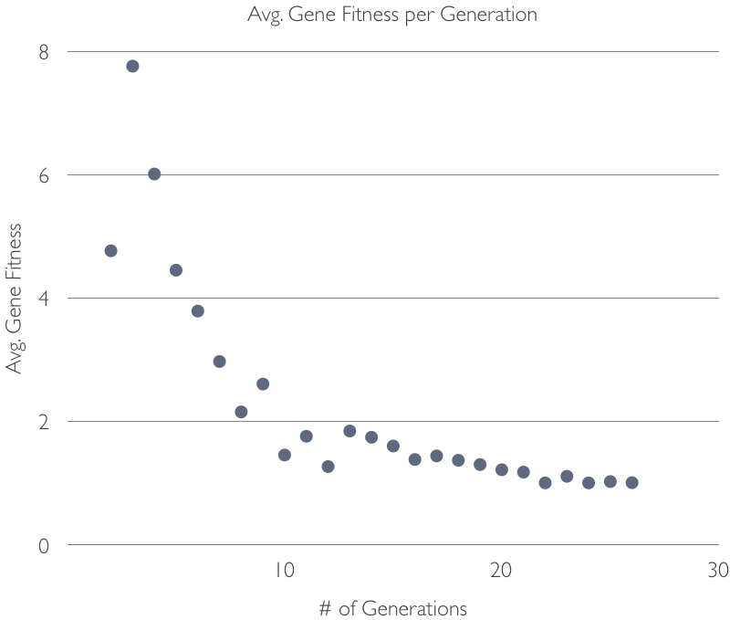

Slide 9
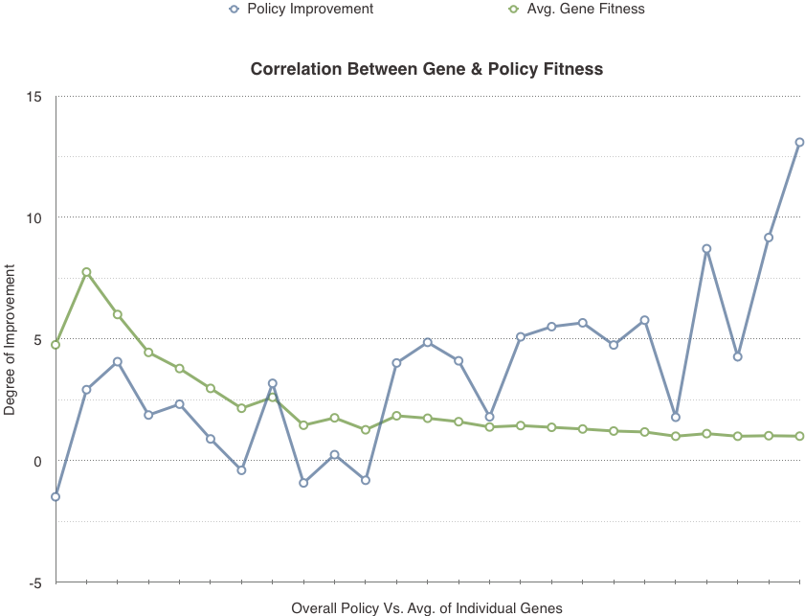

Slide 10
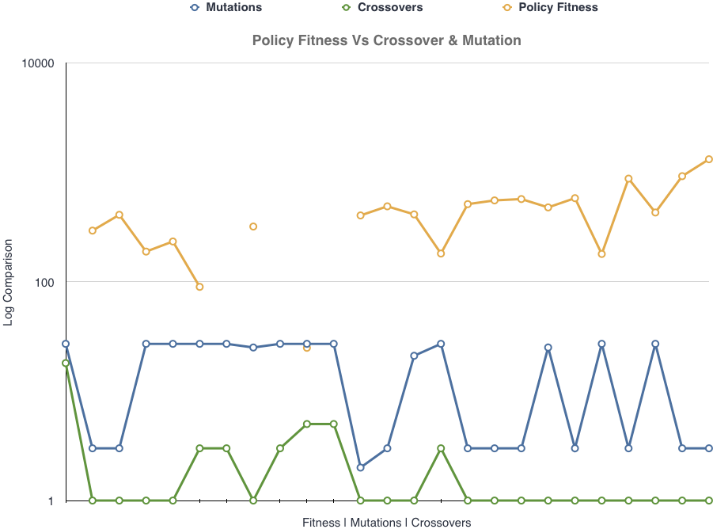

Slide 11
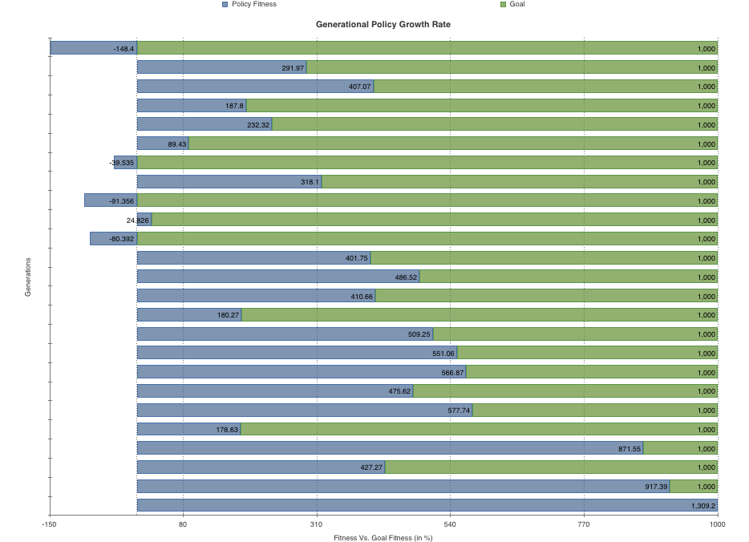

Slide 12
GOAL REACHED!
Case study represents the trivial case where dealer policy is terrible.
However, similar results are seen against better policies.
(The better the dealer, the lower the max improvement attainable)

Slide 13
FUTURE WORK
In real blackjack, the dealer is not your only adversary. Thus we could improve on fitness by playing against multiple adversarial policies! This should lead to larger gains in policy fitness
As seen from the correlation graph between genes and policy, the 2 are very loosely bound. A better fitness function is in order.
A pseudo-coevolution was implemented in this program for the purpose of improving the player's policy faster (not discussed here). Upgrading this to proper co-evolution is desireable.
Finally, having to set parameters such as 1000% i.e 10 times better is too unrealistic. This goes back to the loosely bound fitnesses, but also indicates a possible lack of correlation between my game simulations and an actual game. I might want to investigate this further.

